Slide 1

Clustering Seismic
June 2024

Slide 2
Density-Based Spatial Clustering Algorithm (DBSCAN)
Groups events based on proximity, without predefining the number of clusters allowing for It provides unbiased, data-driven clustering, reflecting the true distribution of seismic events without assumptions or artificial constraints.
Key Benefits:
- Detects clusters of any shape, ideal for irregular patterns in fracking-induced seismicity.
- No need to predefine cluster count, allowing natural event grouping.
- Captures trends in both space and time (lat, long and time)
Added Features
- Added scaling to prioritize/scale time or spatial as desired – allowing for a more in depth and vigorous
dive into the data

Slide 3
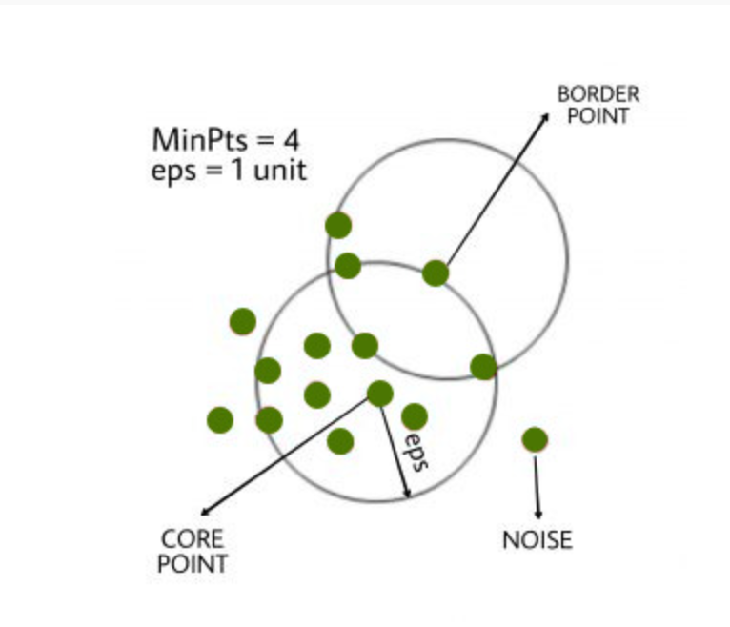
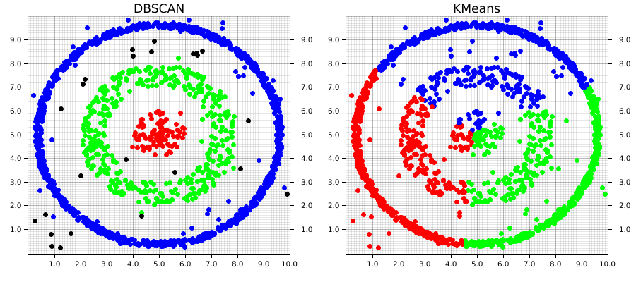

Slide 4
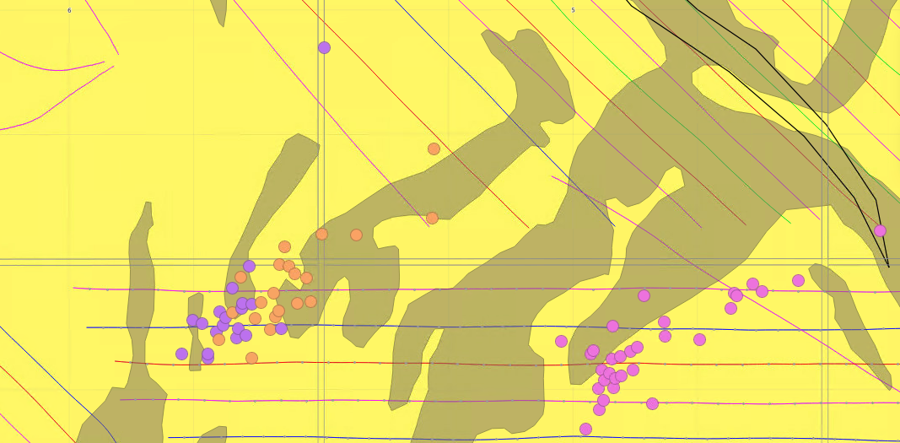
Min Pts = 20, Spatial = 0.7, Temporal = 0.5, EPS = 1.85

Slide 5
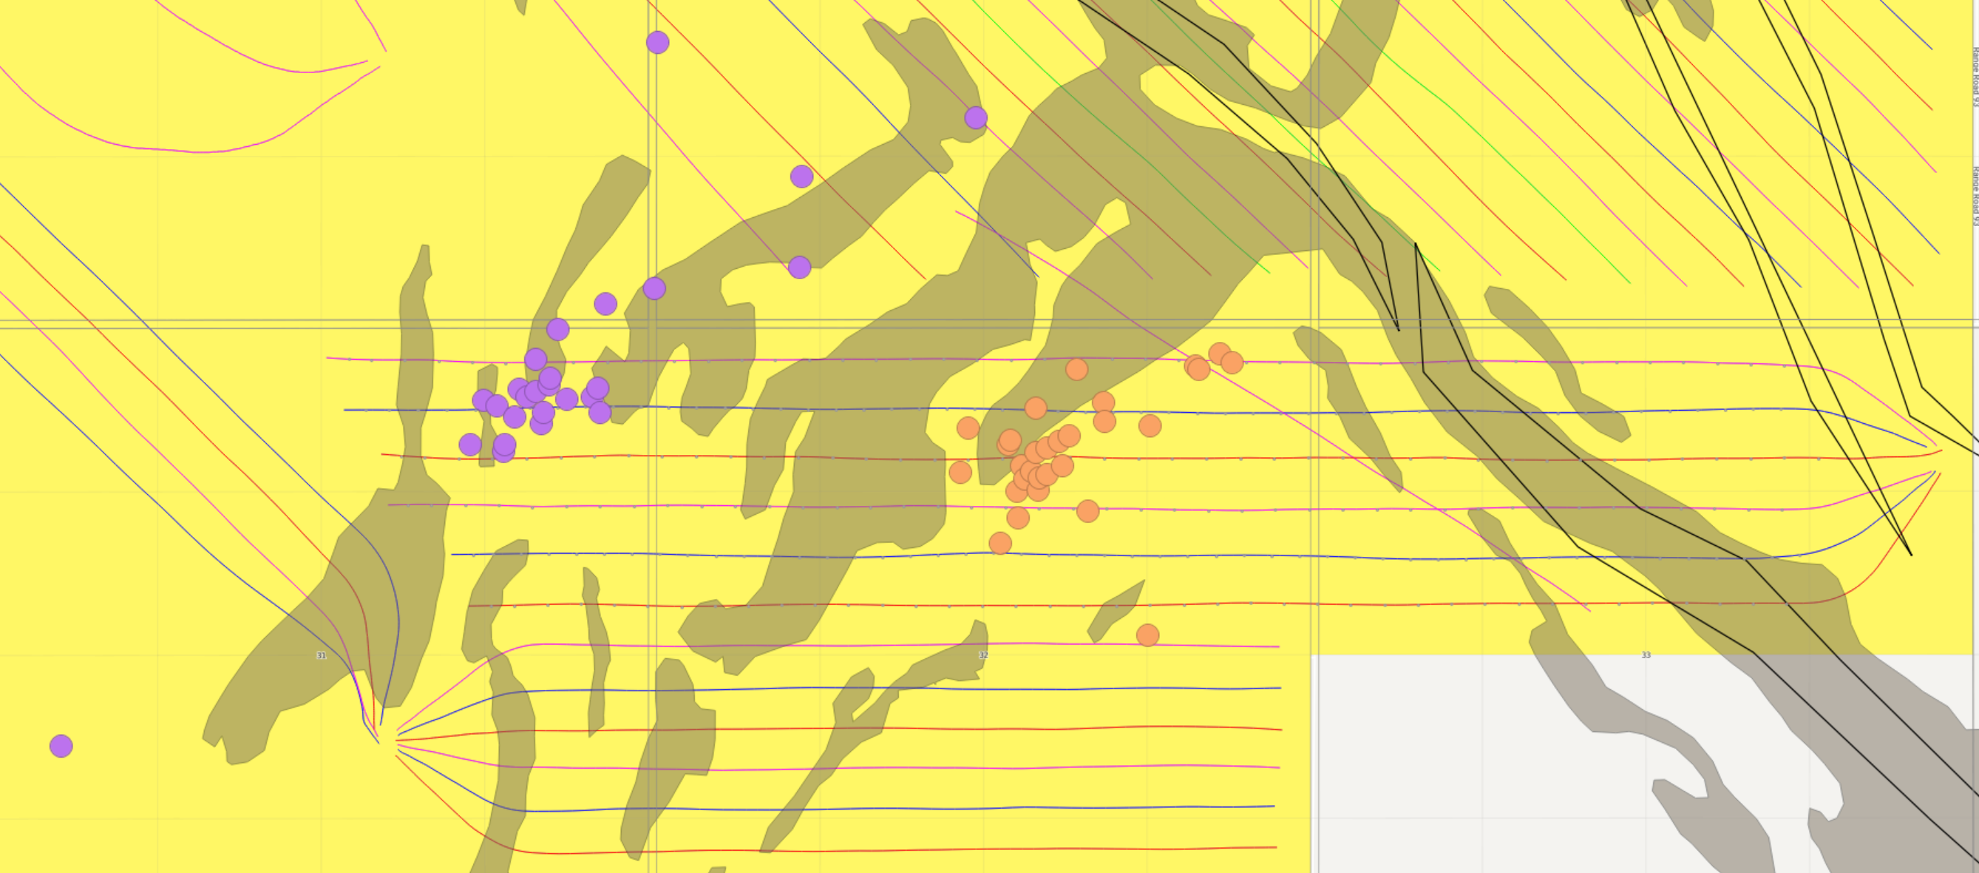
Min pts = 25, Spatial = 0.5, Temporal = 0.5, EPS = 2.00
Takeaway: Macro groupings (only 2 groups met criteria) both show fault correlation

Slide 6
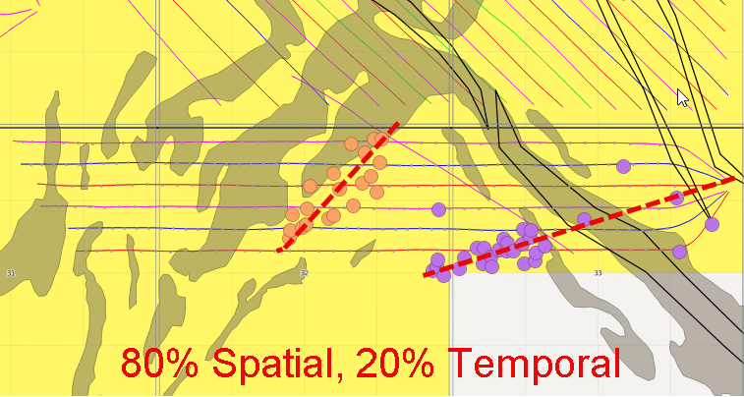
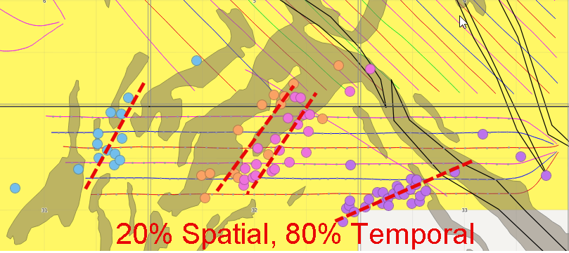
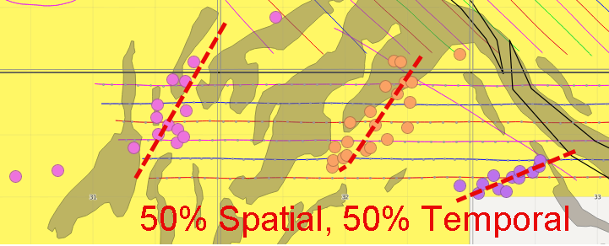
Min Pts = 15
Takeaway: On azimuth, azimuth change likely due to fracking A repeatedly on tail end

